Slide 1




Intro to Data Science
Ben Boby
NTT Data - CDTS
© 2023 NTT DATA Americas, Inc. All rights reserved.

Slide 2
Objective
Brief introduction of the AI and ML topics
Brief introduction to machine learning concepts
Set a context for subsequent deep dive sessions
Increase awareness and understanding of machine learning project lifecycle
Provide a roadmap for learning machine learning

Slide 3
What is Artificial Intelligence
In simple terms, artificial intelligence is computer science that is capable of completing tasks that require human intelligence to complete.

Slide 4


Types of Artificial Intelligence
Reactive Machines
Basic form of AI
Does not learn
Ability to generate 1000s of possibilities from given input
Limited Memory
Stores previously captured and learned data to make predictions
Trained to memorize a data set
An environment is built in which it has ability to correct mistakes and have approved behavior reinforced
The feedback is used to make better decisions in future
Theory of Mind
General concept is that AI system will be able to react in real time to emotions and mental characteristics of a human entity
An example would be AI system to see a wilted plant and understand that it needs to be watered in order to survive
AI system will need to have the ability to look past the data and understand humans often make decisions not purely on logic but rather based on
the mental state of their mind and overall emotions
Self Awareness
AI system has the ability to become self-aware and form its own identity
Machines will have achieved human level consciousness, emotions, empathy
The development of such AI is not possible with today’s technology

Slide 5
Stages of Artificial Intelligence
ANI -
Narrow AI
Also known as “Weak” AI
Capable of handling singular tasks or limited tasks
Tasks where narrow intelligence succeed as language translation, image recognition etc.
AGI -
General AI
Also known as “Strong” AI
A form of machine learning that simulates human cognitive systems by completing different tasks
Systems learn, execute, reason, and more but do not experience consciousness.
ASI -
Super AI
Machines become “Sentient”
Most advanced form of machine learning
Systems programmed in a way that its decision-making ability and ability to mimic human intelligence is way better than humans

Slide 6
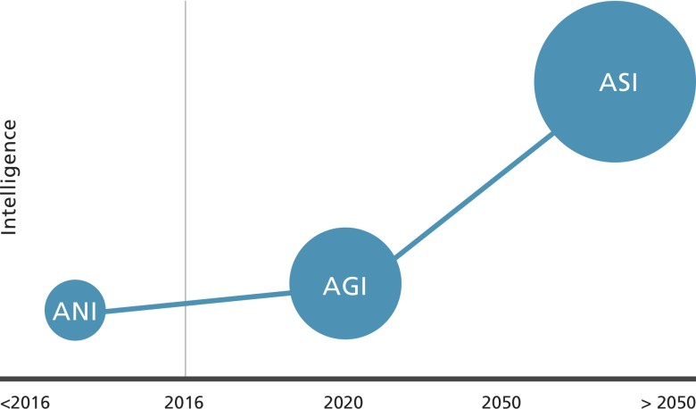
Stages of Artificial Intelligence
https://cloudxlab.com/blog/stages-of-artificial-intelligence/

Slide 7
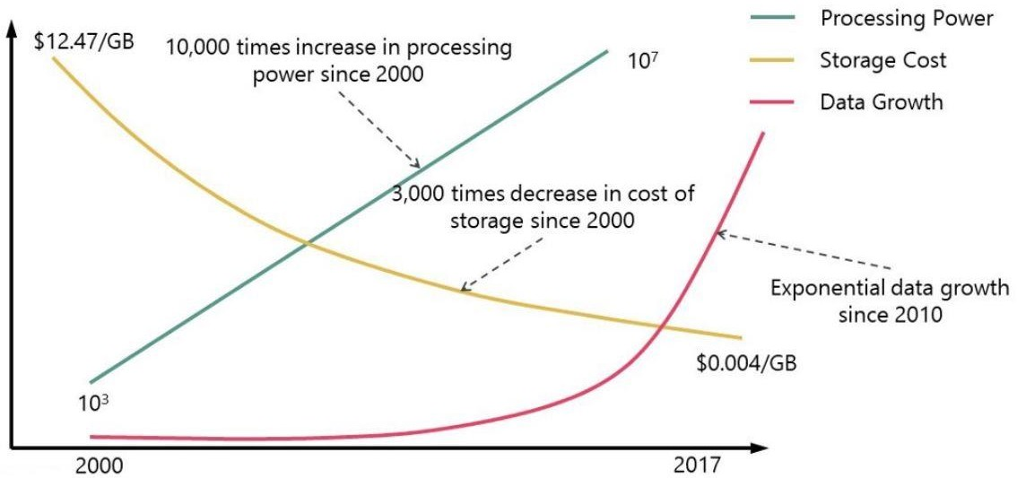
Why AI is on the rise
https://www.eteam.io/blog/computer-engineering-automated

Slide 8
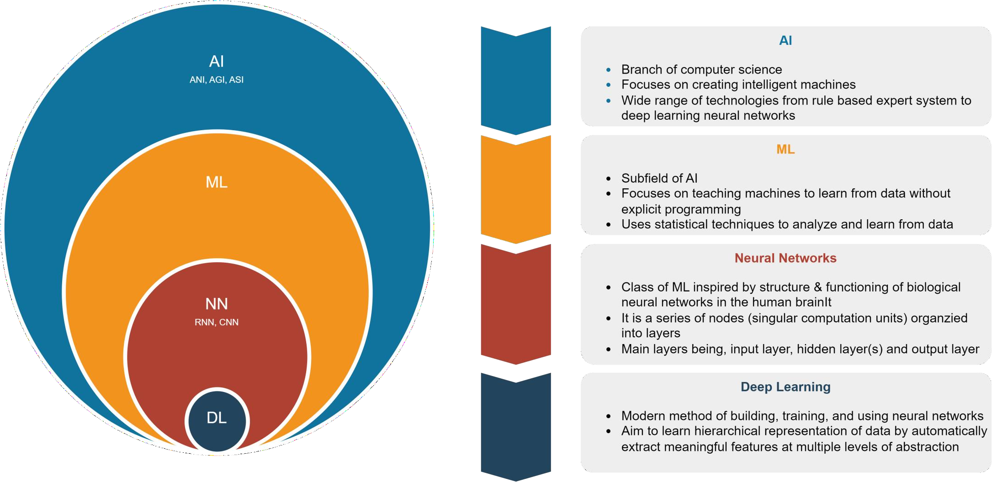
Artificial Intelligence, Machine Learning, Neural Networks, Deep Learning

Slide 9
Applications
Natural Language Processing (NLP): ML algorithms can be used to analyse and understand human language, and perform tasks such as language translation, sentiment analysis, and text classification. This has applications in chatbots, virtual assistants, and customer service.
Computer Vision: ML algorithms can be used to analyse and understand images and videos, and perform tasks such as object detection, facial recognition, and image segmentation. This has applications in autonomous vehicles, security systems, and medical imaging.
Fraud Detection: ML algorithms can be used to detect fraudulent behaviour in financial transactions, insurance claims, and other areas. This has applications in finance, insurance, and e-commerce.
Recommendation Systems: ML algorithms can be used to make personalized recommendations based on a user's preferences and behaviour. This has applications in e-commerce, streaming services, and social media.

Slide 10
Applications
Predictive Maintenance: Machine learning algorithms are used to predict when machines or equipment are likely to fail, so that maintenance can be scheduled before a breakdown occurs. This has applications in manufacturing, transportation, and energy.
Healthcare: Machine learning algorithms are used to analyse patient data and medical images, and make predictions about disease diagnosis and treatment outcomes. This has applications in medical diagnosis, drug discovery, and personalized medicine.
Finance: Machine learning algorithms are used to predict stock prices, detect fraudulent behaviour, and analyse customer behaviour. This has applications in investment banking, asset management, and risk management.
Marketing: Machine learning algorithms are used to analyse customer behaviour, predict customer churn, and optimize marketing campaigns. This has applications in digital marketing, advertising, and customer relationship management.

Slide 11
What is a Machine Learning Algorithm
A machine learning algorithm is a computational method or procedure that enables a machine or computer system to learn patterns or make predictions from data without being explicitly programmed.

Slide 12
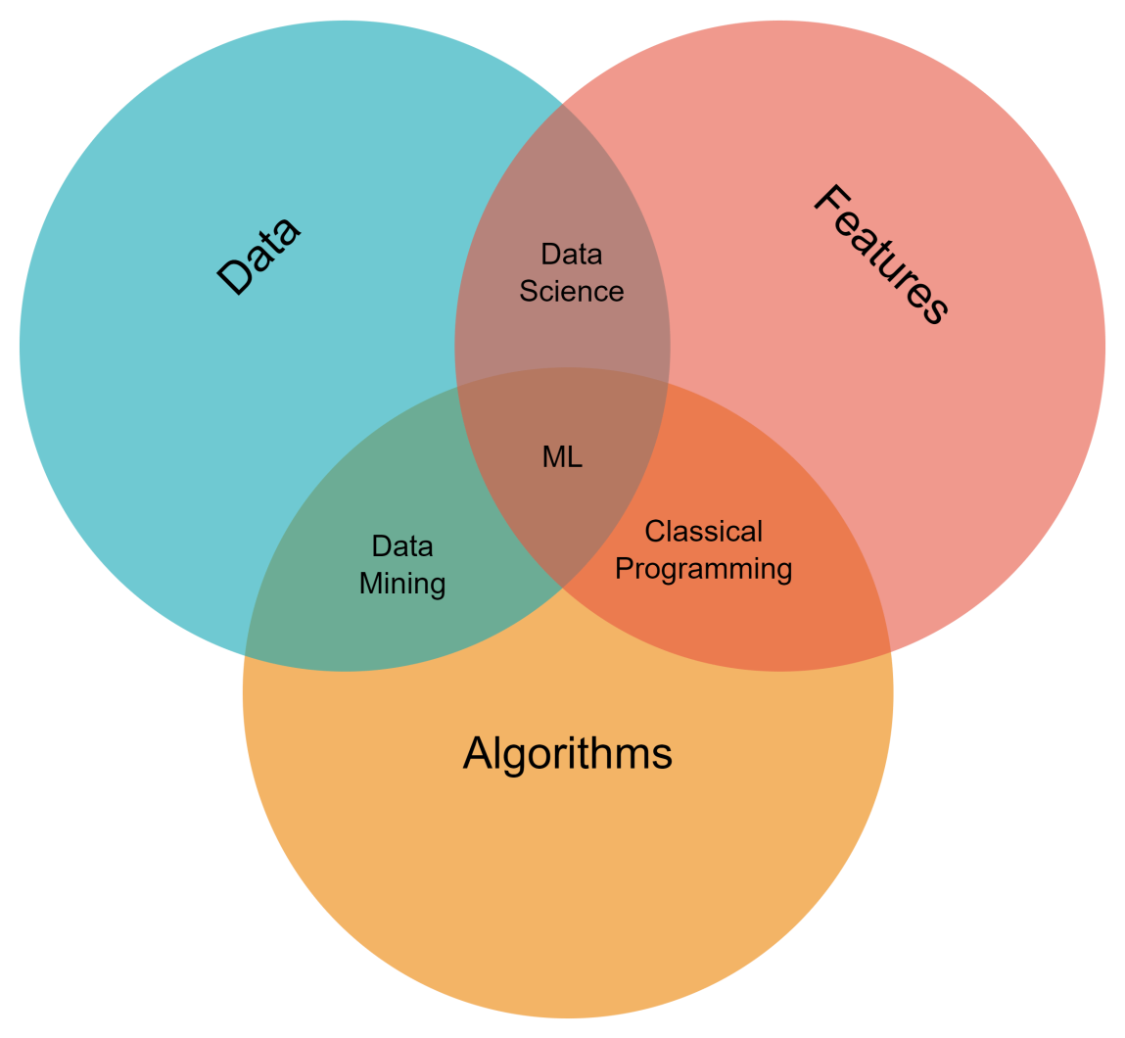
3 Components of Machine Learning
Data – Primary driver for any kind prediction.
» Ways to get data , manual and auto
» Manual collection is more accurate but time
consuming
» Automatic collection is faster but error prone
Features – Also known as parameters
» Examples could be car mileage, make, engine
capacity,
» Data stored in tables it’s simple, columns of the table
» Images are complex. Each pixel is not a feature.
» Feature engineering is error prone
Algorithms
» Any problem can be solved differently
» The method we choose affects precision, performance and size of the model

Slide 13

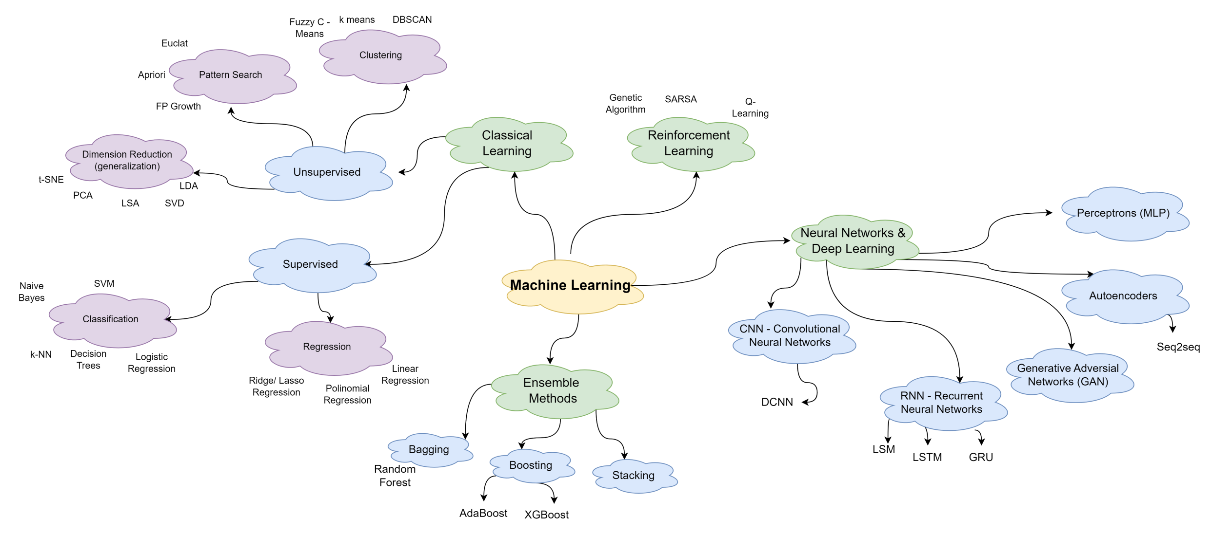
Mapping the ML World

Slide 14
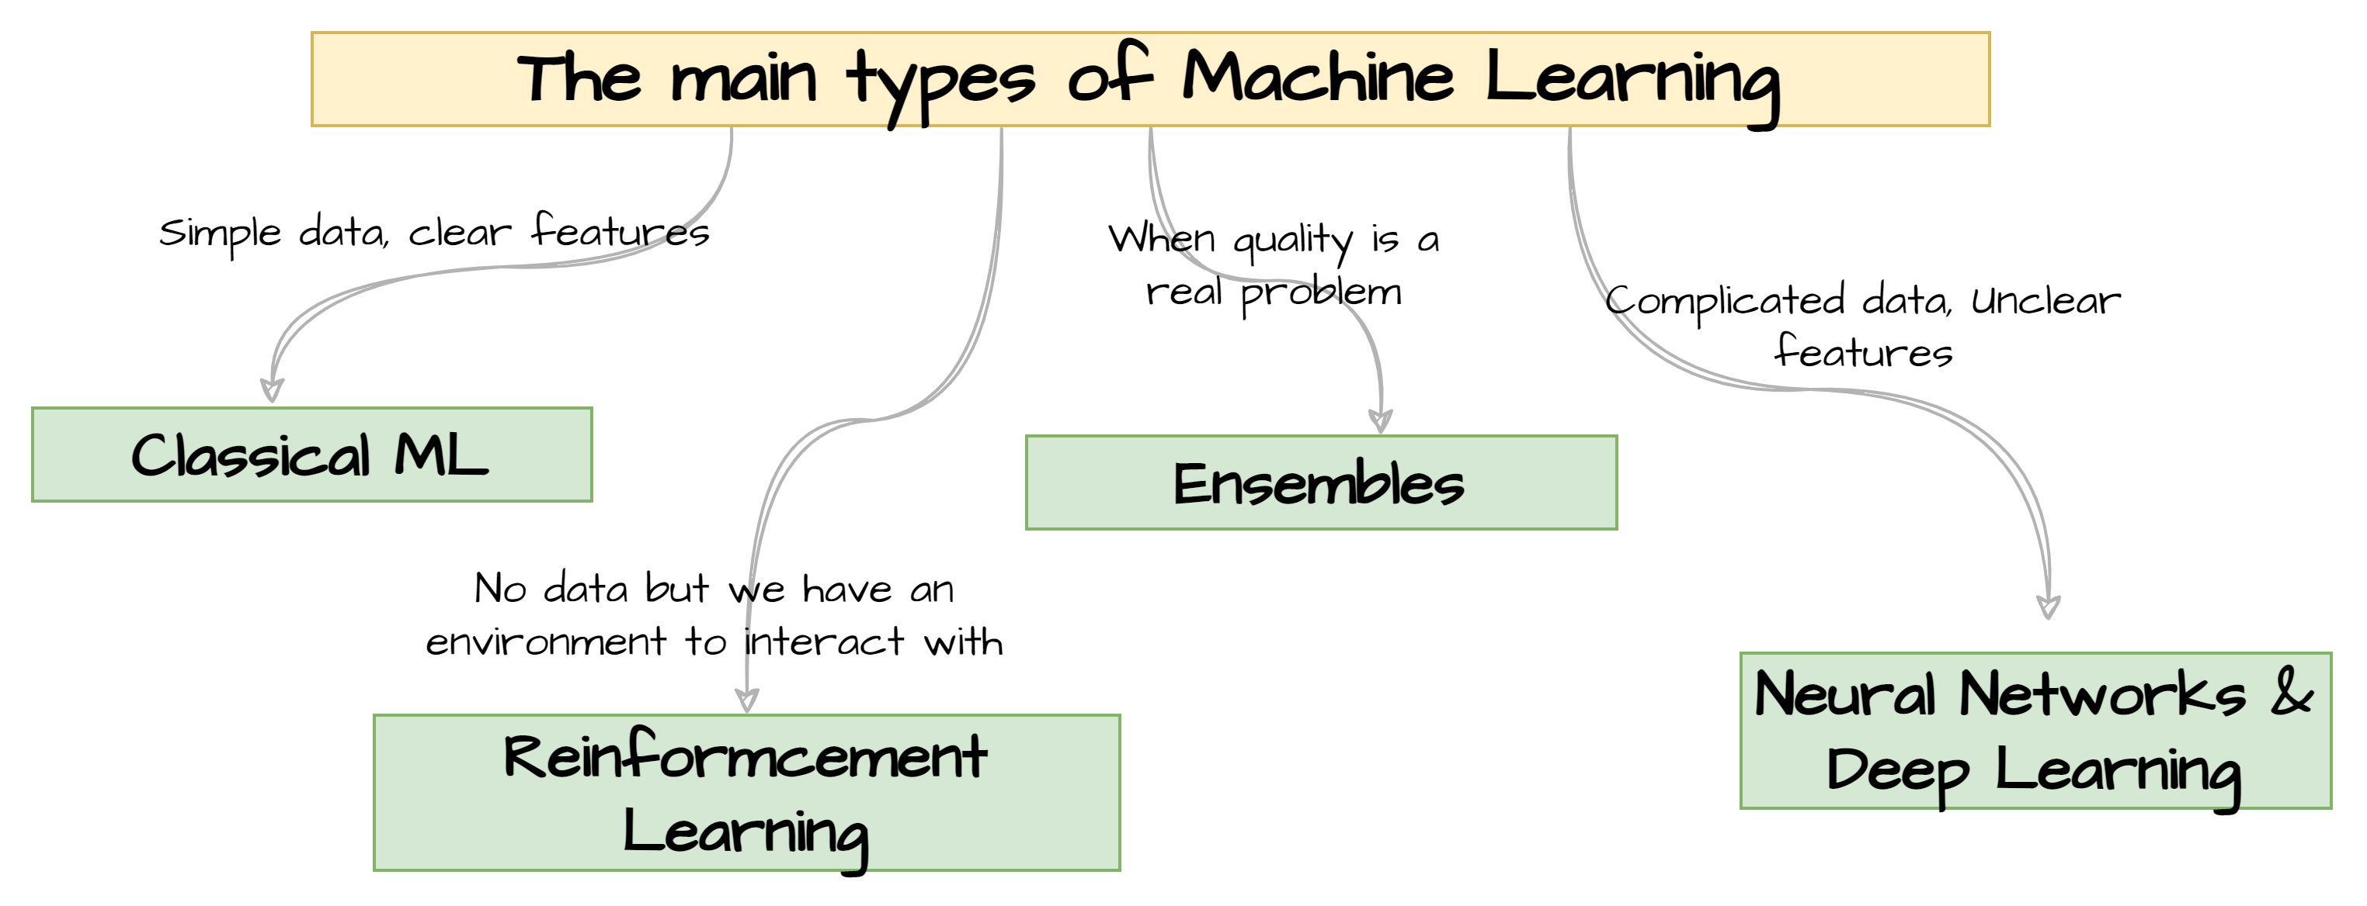
Mapping the ML World

Slide 15

Neural Networks
© 2020 NTT DATA, Inc. All rights reserved.

Slide 16
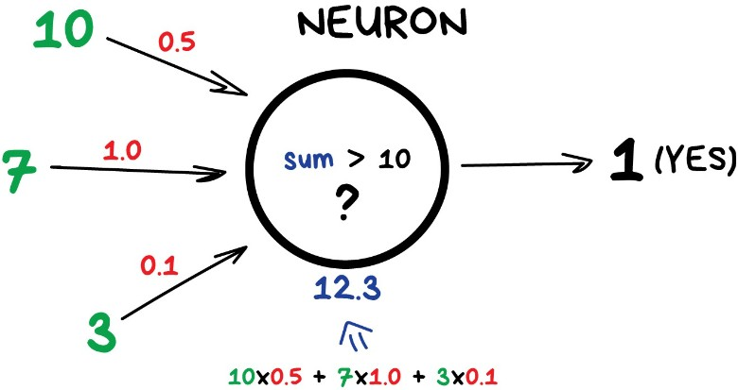
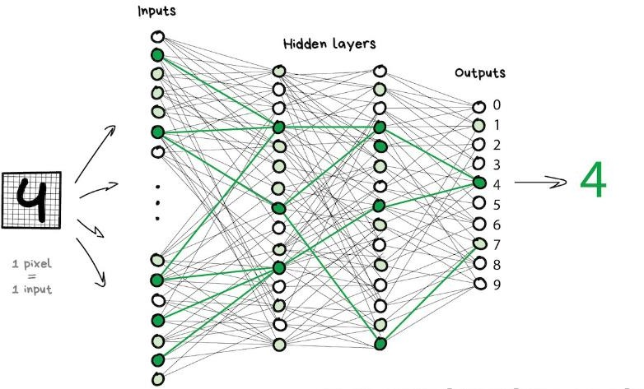
Neural Networks
Neural networks also known as Artificial Neural Networks (ANN) or Simulated Neural Networks (SNN)
Consists of “neurons” and connections between them.
Neuron is a node/function with a bunch of inputs and 1 output
Connections are channels between neurons. Each connection has 1 parameter - weight
•

Slide 17
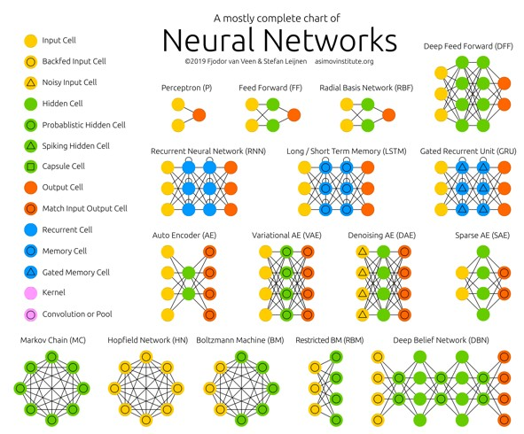
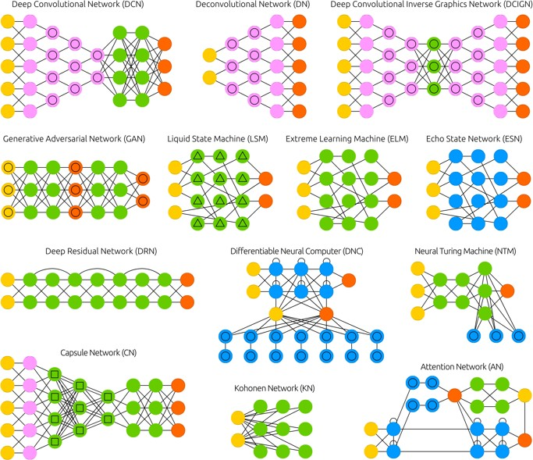
Neural Networks
https://www.asimovinstitute.org/neural-network-zoo/

Slide 18
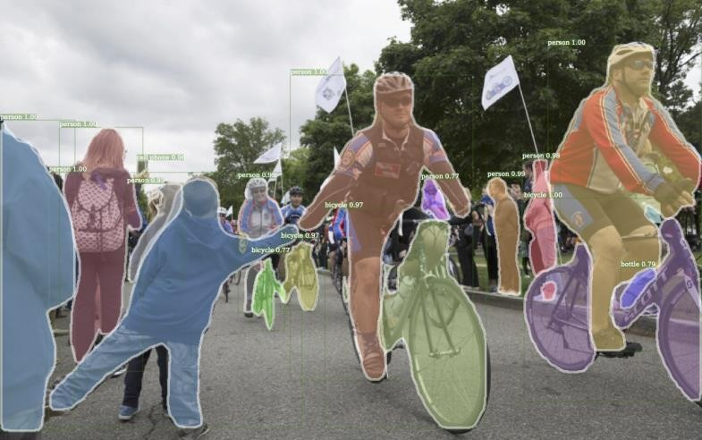
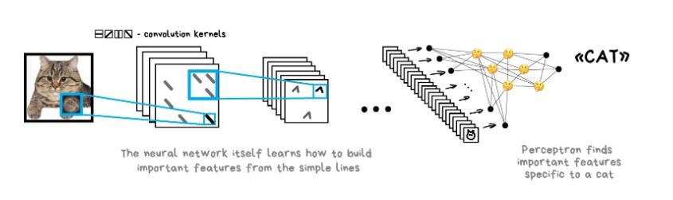
Convolution Neural Networks (CNN)
Used to search for objects on photos and in videos, face recognition, style transfer, generating and enhancing images, creating effects like slow-mo and improving image quality
Difficult to extract features out of the
images. Uses “handcrafting features”
They have three main types of layers,
which are:
Convolutional layer
Pooling layer
Fully-connected (FC) layer
Image below is a result produced
by Detectron that was recently open-
sourced by Facebook

Slide 19
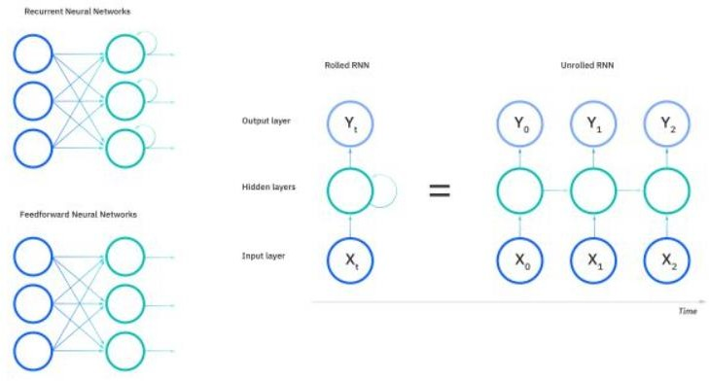
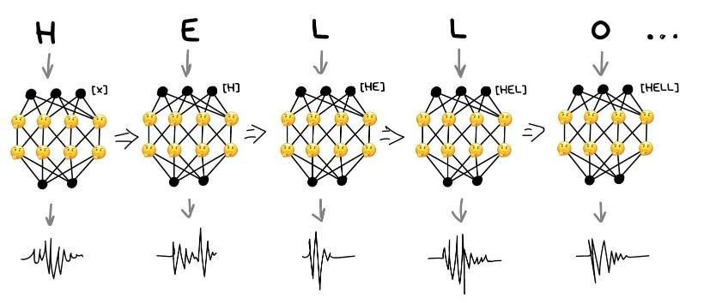
Recurrent Neural Networks (RNN)
Recurrent networks gave us useful things like neural machine translation, speech recognition and voice synthesis in smart assistants. RNNs are the best for sequential data like voice, text or music.
Distinguishing characteristic of recurrent networks is that they share parameters across each layer of the network.
RNNs tend to run into two problems, known as exploding gradients and vanishing gradients. These issues are defined by the size of the gradient, which is the slope of the loss function along the error curve.

Slide 20
Large Language Models
© 2020 NTT DATA, Inc. All rights reserved.
20

Slide 21
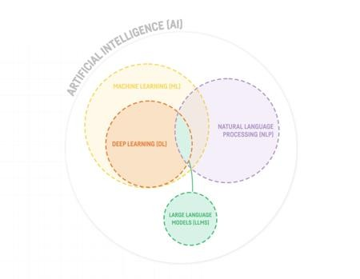
Large Language Models
A large language model (LLM) is a language model consisting of a neural network with many parameters (typically billions of weights or more), trained on large quantities of unlabelled text using self-supervised learning.
LLMs emerged around 2018 and perform well at a wide variety of tasks. This has shifted the focus of natural language processing research away from the previous paradigm of training specialized supervised models for specific tasks
Some of the LLMs
BERT - Bidirectional Encoder Representation from
Transformers - Google
GPT – Generative Pretrained Transformers - OpenAI
OPT - Open Pretrained Transformers – Meta
BLOOM – BigScience Large Open-science Open- access Multilingual language model - HuggingFace

Slide 22
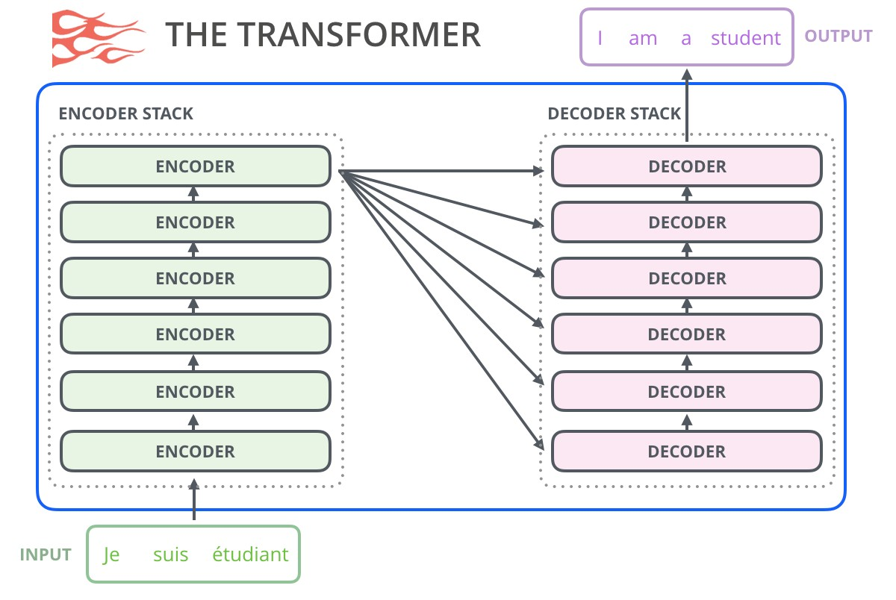
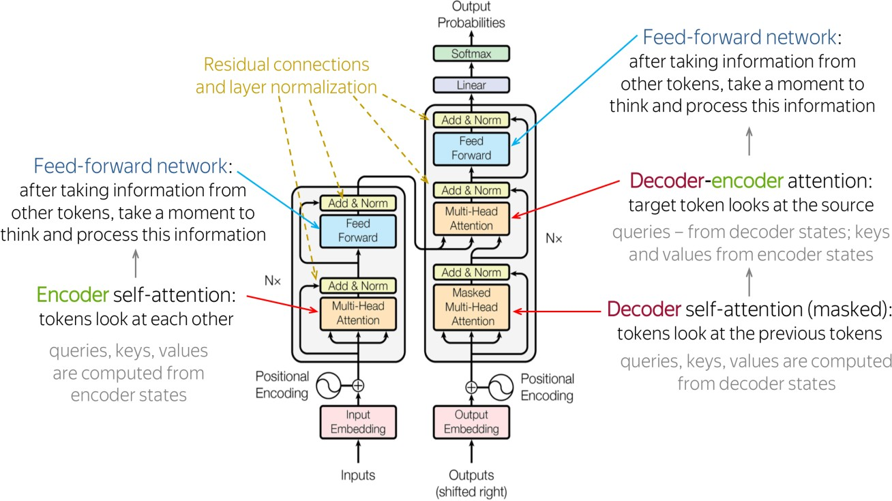
Transformer Model
A transformer model is a neural network that learns context and thus meaning by tracking relationships in sequential data like the words in this sentence.
Transformer models apply an evolving set of mathematical techniques, called attention or self-attention, to detect subtle ways even distant data elements in a series influence and depend on each other.
https://ai.googleblog.com/2017/08/transformer-novel-neural-network.html https://blogs.nvidia.com/blog/2022/03/25/what-is-a-transformer-model/ https://jalammar.github.io/illustrated-gpt2/
https://lena-voita.github.io/nlp_course/seq2seq_and_attention.html#transformer_model_architecture

Slide 23
GPT
GPT
» Generative – predicting next word (language model)
» Pretrained – previously trained on large amount of data
» Transformers – Encoder/Decoder based neural networks
Chat GPT - GPT finetuned for conversations

Slide 24
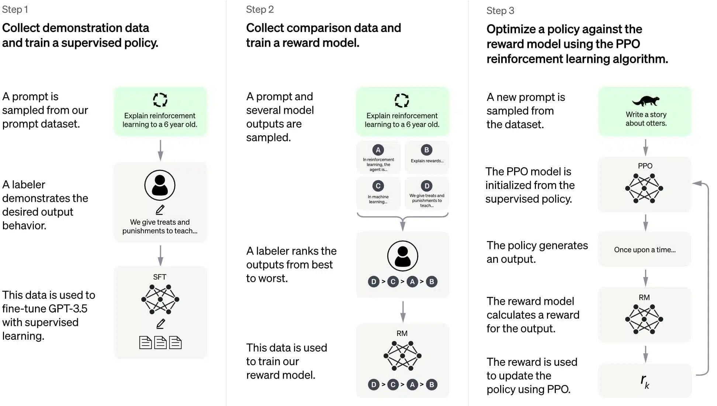
Chat GPT
https://www.atriainnovation.com/en/how-does-chat-gpt-work/

Slide 25
GPT Evolution
GPT 1
(2018)
GPT 2
(2019)
GPT 3
(2020)
GPT 3.5
(2022)
GPT 4.0
(2023)
12 Layers of transformers
12 Layers of transformers
24 Layers of transformers
48 Layers of transformers
96 Layers of transformers
512 Tokens
1024 Tokens
2049 Tokens
4096 Tokens
8192 Tokens
5 GB of corpus
(Books)
40 GB of corpus
(Books, web text)
45 TB of
corpus
175 TB of
corpus
600 TB of
corpus
117
parameters
1.5 B
parameters
175 B
parameters
300 B
parameters
16 T
parameters
https://internationaljournalofresearch.com/2023/04/07/evolution-of-chatgpt/
https://en.wikipedia.org/wiki/ChatGPT

Slide 26
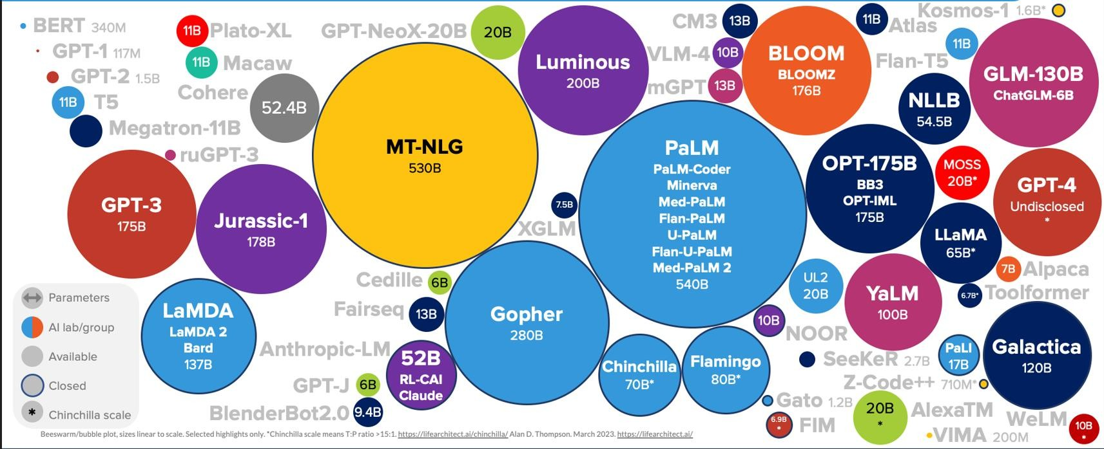
Large Language Model Sizes (as of Mar 2023)
https://lifearchitect.ai/

Slide 27
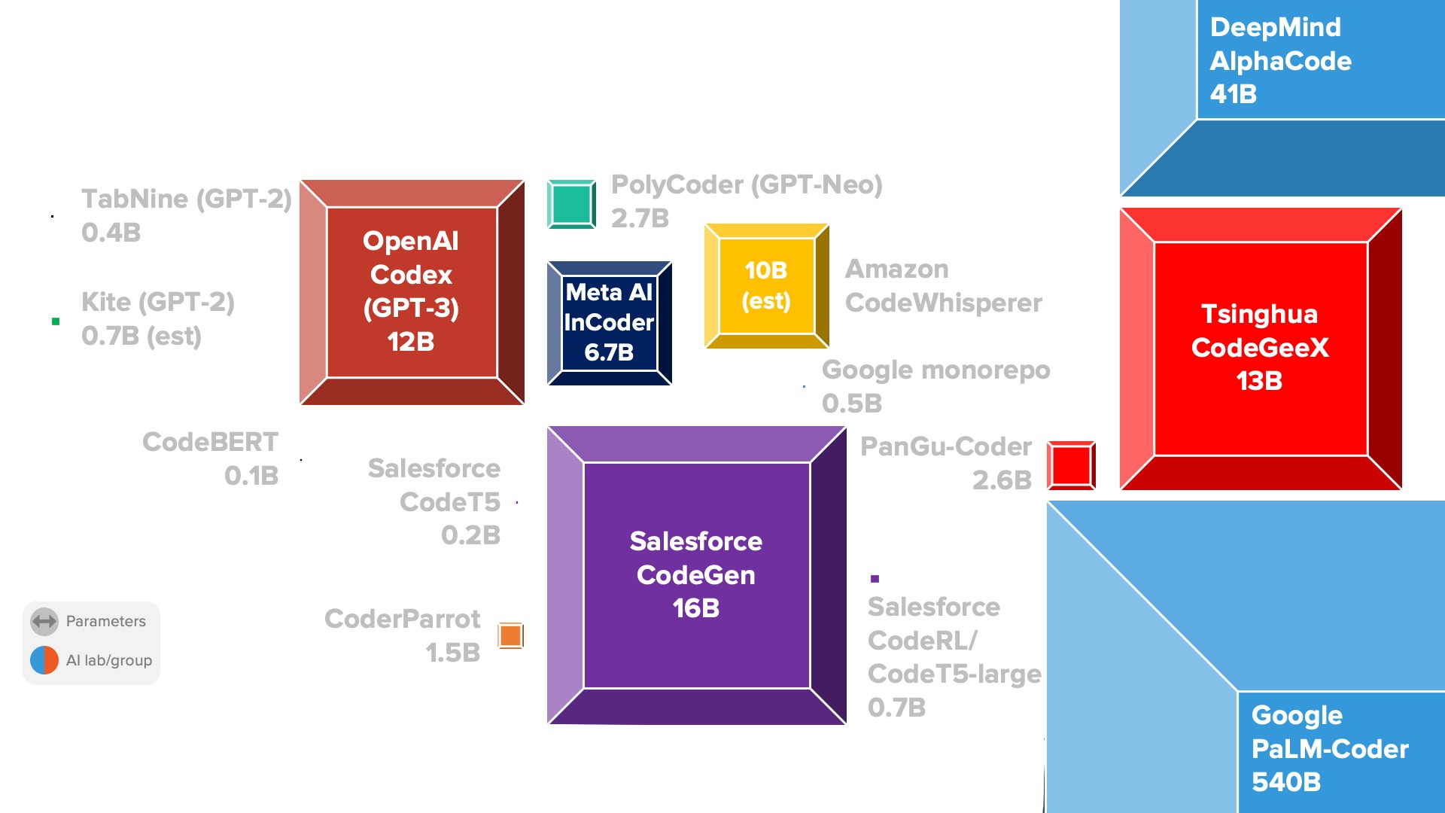
Codex (Code Generator) Model Sizes (as of Oct 2022)
https://lifearchitect.ai/

Slide 28



Large Language Model API or Hosted (Plane analogy)
Boeing 787
GPT-4, PaLM …
API Only (leased)
Cessna
Flan-T5, Pythia …
Hosted (owned)
Paper Plan Alpaca, Koala … Hosted (owned)
https://lifearchitect.ai/models

Slide 29

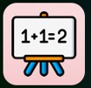



























Achievements unlocked by LLMs
GPT3 13B, PaLM 8B
Mod. Arithmetic
Debugging
Comprehension
GPT3 175B, LaMDA 137B PaLM 64B
Chinchila 7B
Linguistic Puzzles
Emoji Movies
GRE - Comprehension Metaphor Understanding Physical Intuition
Logical Deduction
PaLM 540B
Chinchila 70B
Geometric Shape
Proverbs
Phonetic Alphabets
Elementary Math
Casual Judgement
Code Line Desc.
GPT4,
Gemini (est.)
College-Level
exams
Self-Critique
App Building
Spatial Reasoning
Advanced Creativity
Embodiment Options
https://lifearchitect.ai/models
Grounding
Long-Horizon Planning
Persuasion
Advanced Embodiment
Awareness
More….

Slide 30
Machine Learning Project Lifecycle
© 2020 NTT DATA, Inc. All rights reserved.
30

Slide 31
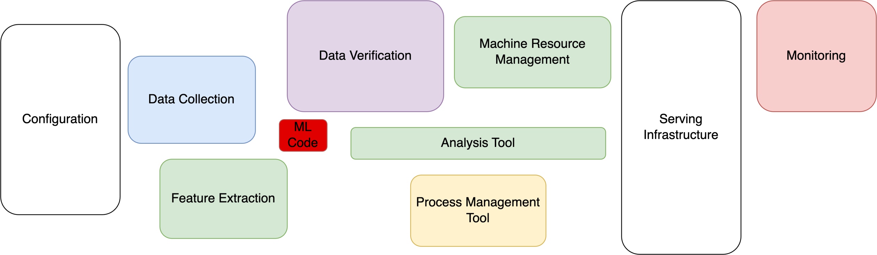
Hidden Tech debt in ML Systems
Only a small fraction of real-world ML systems is composed of the ML code, as shown by the small red box in the middle. The required surrounding infrastructure is vast and complex.
NIPS 2015 and Machine Learning Research at Google. Hidden Technical Debt in Machine Learning Systems
© 2019 NTT DATA, Inc. All rights reserved.
31

Slide 32
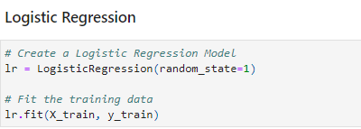
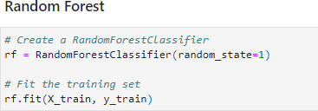
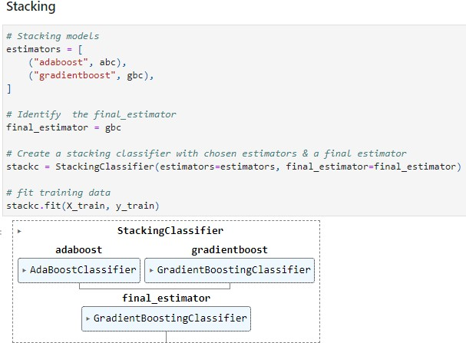
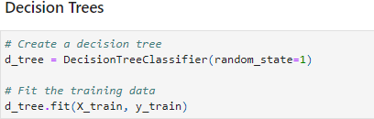
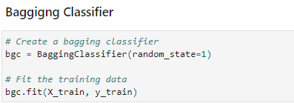
Algorithms in Code

Slide 33
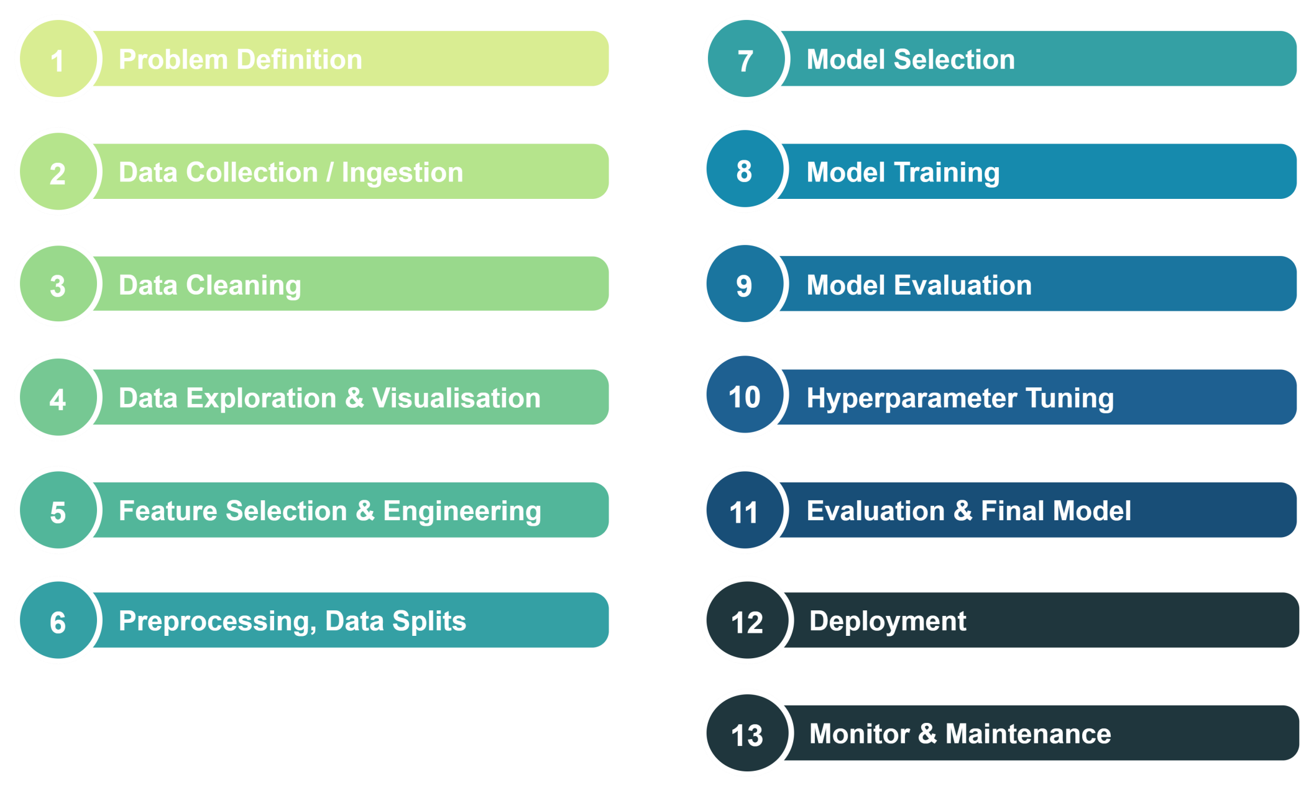
Machine Learning Lifecycle

Slide 34
Problem Definition
Understand the business and the use case that is in scope and define a proper problem statement
Translate a business problem to an AI problem
Understand the data available and data to be collected
Milestones and Planning
Roles: Business Analyst, Solution Architect

Slide 35
Data Collection / Ingestion
Roles: Data Analyst, Data Engineer
Collect relevant data that you can use to train and test your model.
Considerations
» What is the problem that we are trying to solve
» What data source already exists
» How much data is needed
» How do we bring in new data required to solve the problem
» What are the privacy concerns
» Is the dataset public
» Where and how do we store the data

Slide 36
Data Collection contd.
Types of data
» Structured Data
Nominal / Categorical data
Numerical / Continuous data
Ordinal Data
Time series data
» Unstructured Data
No rigid structure

Slide 37
Data Cleaning
Roles: Data Analysts, Data Engineer
Clean the data to remove missing values, outliers, and irrelevant features, and convert the data into a format that can be used for machine learning.
Techniques includes
» Formatting – data is acquired from multiple sources. The task is to standardize the record formats.
» Data cleaning – procedures that allows for removing and fixing inconsistencies.
Duplicates
Data validity checks
» Data anonymization – techniques to anonymize and exclude sensitive information
» Data sampling – select a smaller but representative data sample to build and run models

Slide 38
Data Exploration and Visualization
Roles: Data Analysts, Data Scientist
Data exploration involves analysing the data to understand its characteristics, such as its size, structure, and distribution.
This includes performing basic statistical analysis, such as calculating the mean, median, and standard deviation, as well as more advanced techniques, such as clustering, principal component analysis, and data profiling.
The goal of data exploration is to identify any data quality issues, anomalies, or patterns that may impact the modelling process.
Data visualization is an important part of data exploration that involves creating visual representations of the data to facilitate understanding and communication.
Visualization techniques can include scatter plots, histograms, box plots, heat maps, and other types of charts and graphs. Visualization can help identify trends, patterns, and outliers in the data and can aid in making decisions about which features to use in the model.

Slide 39
Feature Selection and Feature Engineering
Roles: Data Analysts, Data Scientist
Feature selection is the process of selecting a subset of relevant features from a larger set of available features. The goal of feature selection is to reduce the dimensionality of the data, eliminate irrelevant or redundant features, and improve the accuracy and efficiency of the model.
Feature selection can be performed using various techniques such as correlation analysis,
forward/backward selection, and feature importance estimation.
Feature engineering is the process of creating new features from the available data that may improve the performance of the model. Feature engineering involves applying domain knowledge to transform and extract relevant information from the data.
Some common techniques used in feature engineering include scaling, normalization, one-hot encoding, binning, and dimensionality reduction.

Slide 40
Preprocessing and Split
Preprocessing involves transforming and preparing the data to be used in the model. This can include various techniques such as cleaning, normalization, scaling, encoding, and feature selection. The goal of preprocessing is to ensure that the data is in a suitable format for the ML algorithm to learn from.
Splitting the data involves dividing the data into two or more parts for training and testing the model. Typically, the data is split into two parts: the training set and the testing set. The training set is used to train the model, while the testing set is used to evaluate the performance of the model on unseen data. Splitting the data ensures that the model is not overfitting to the training data and can generalize well to new data.
There are different ways to split the data, such as random, stratified, or time-based splitting, depending on the type of data and the goals of the project. Cross-validation is also a popular technique for splitting the data into multiple folds to train and test the model on different subsets of the data.
Roles: Data Scientist

Slide 41
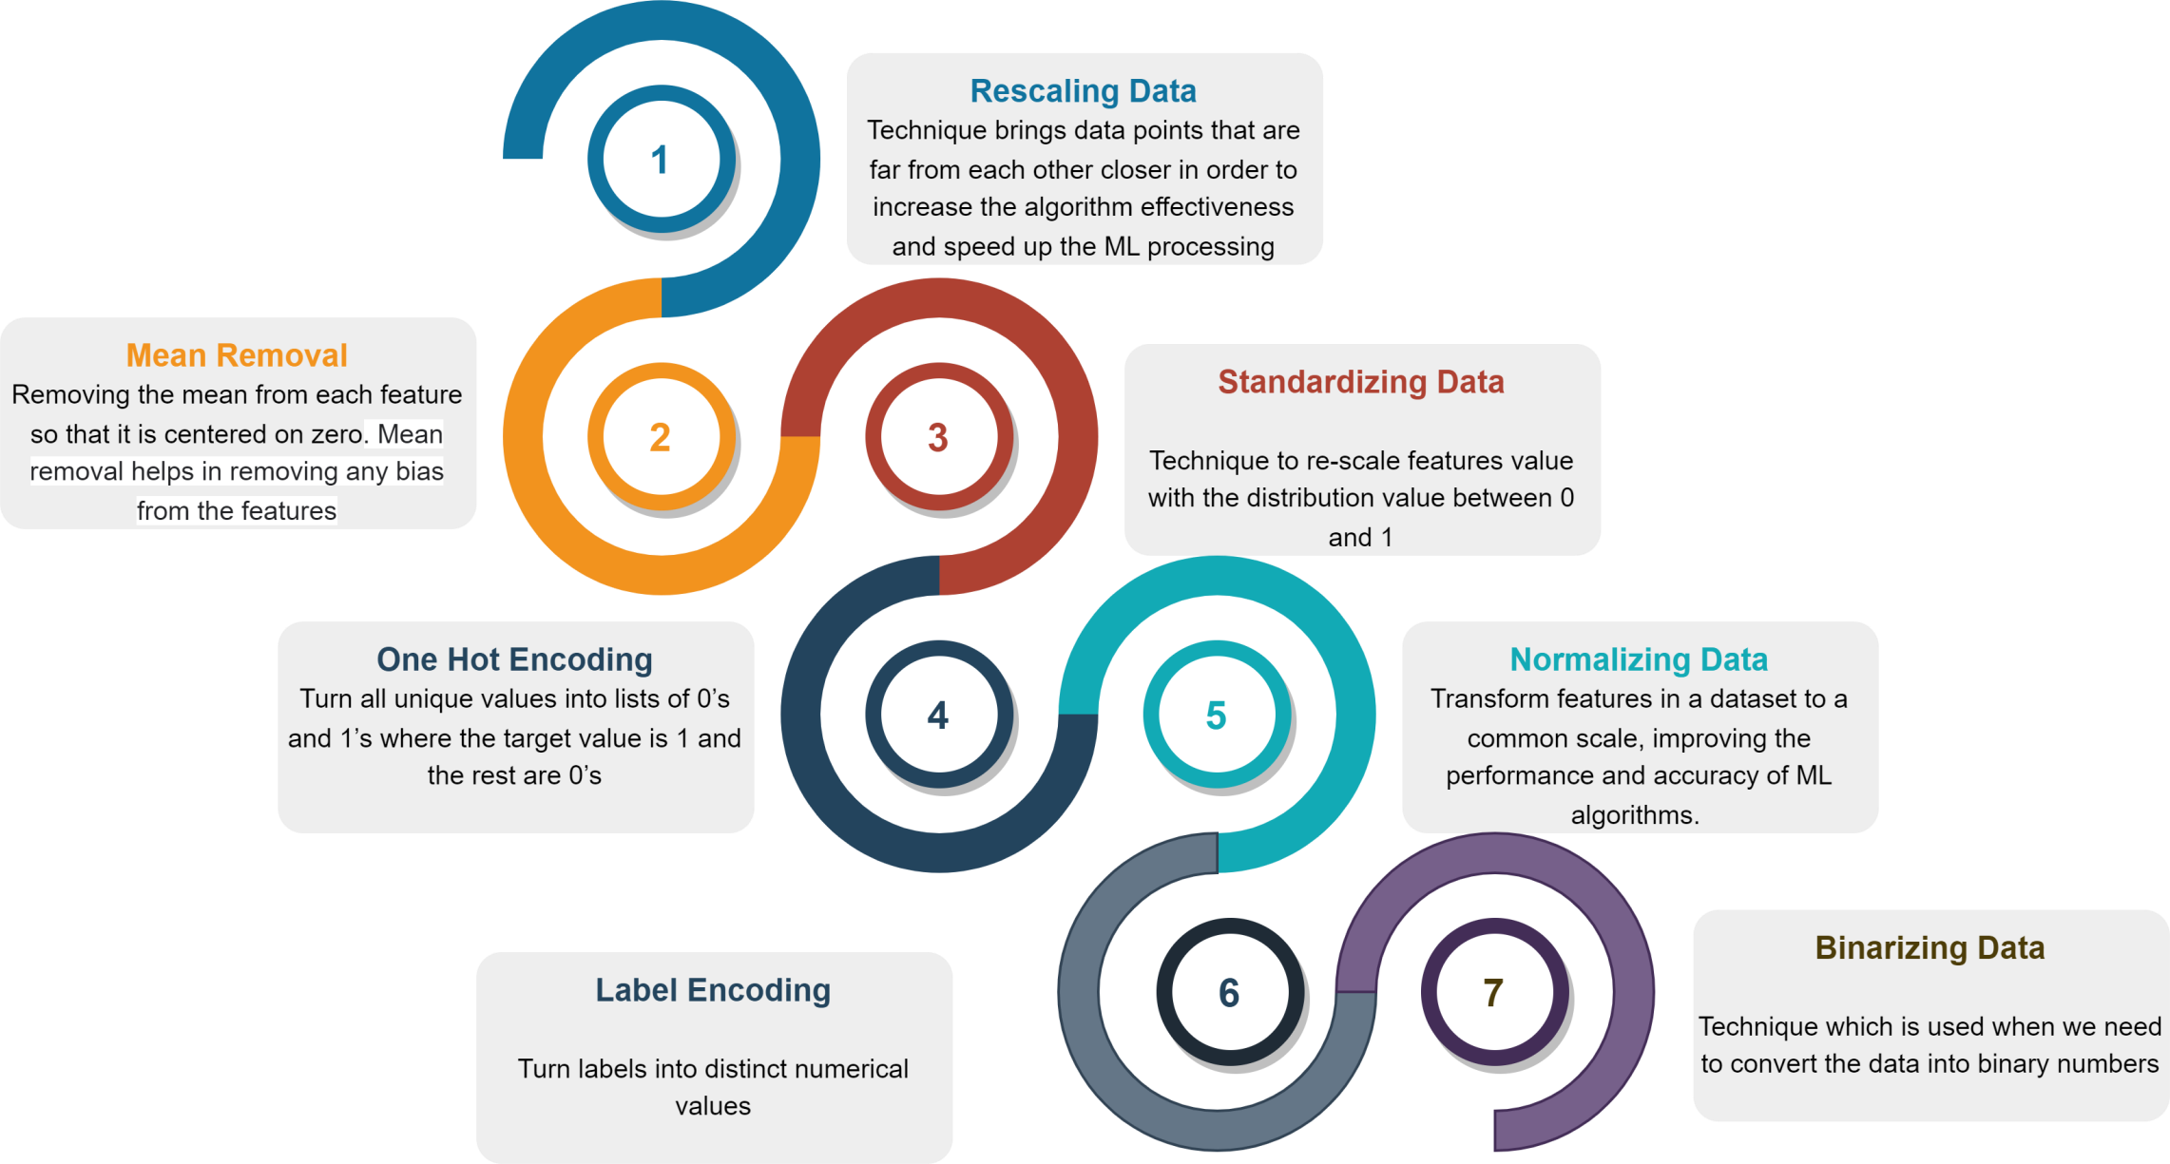
Scaling and Encoding
Roles: Data Scientist

Slide 42
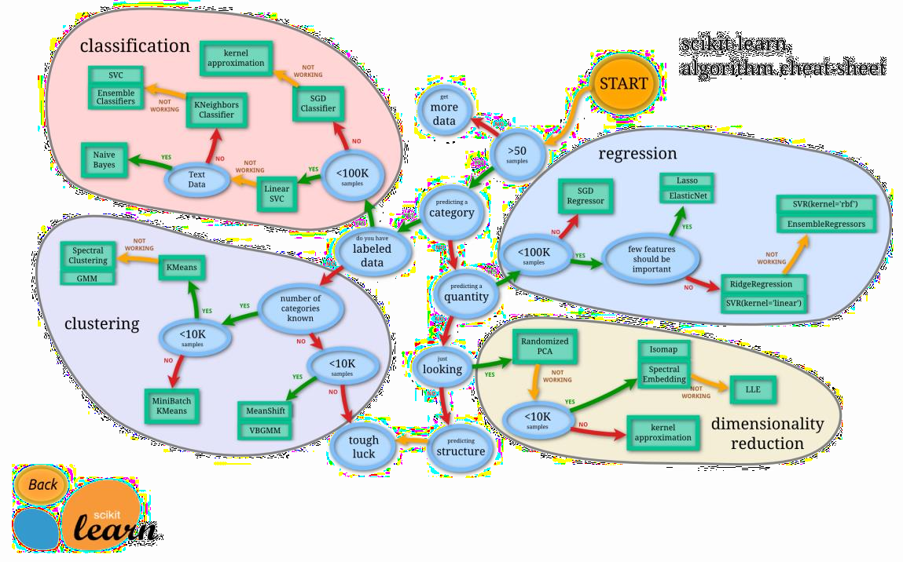
Model Selection
Roles: Data Scientist
Choose the most appropriate machine learning algorithm and model that can solve the problem
Factors to consider
» The size, quality and nature of data
» The available computation time
» The urgency of the task
» What you want to do with the data

Slide 43
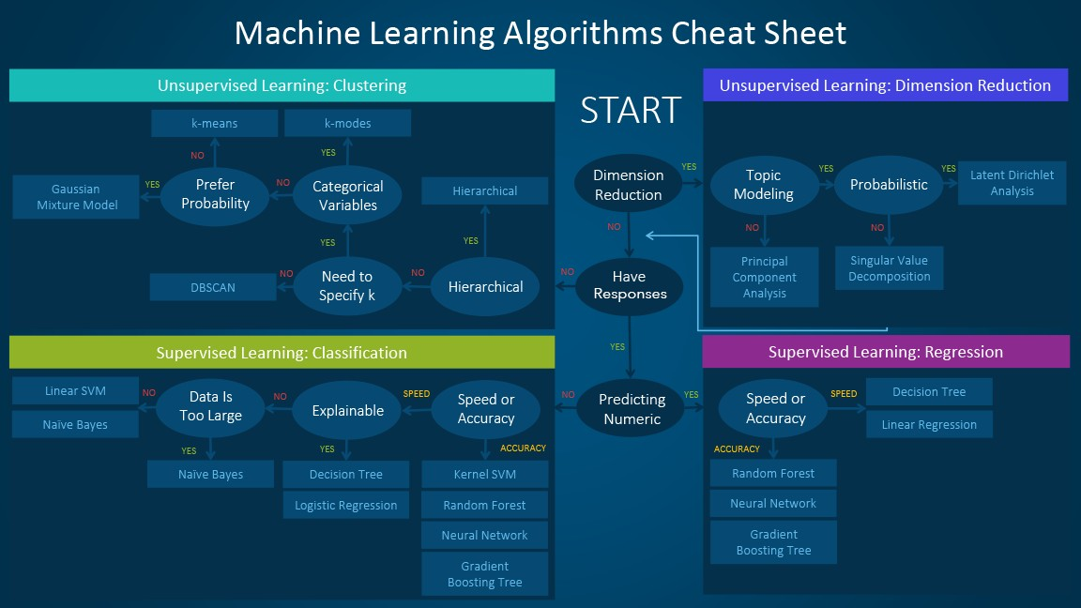
Model Selection
Roles: Data Scientist
https://blogs.sas.com/content/subconsciousmusings/2020/12/09/machine-learning-algorithm-use/

Slide 44
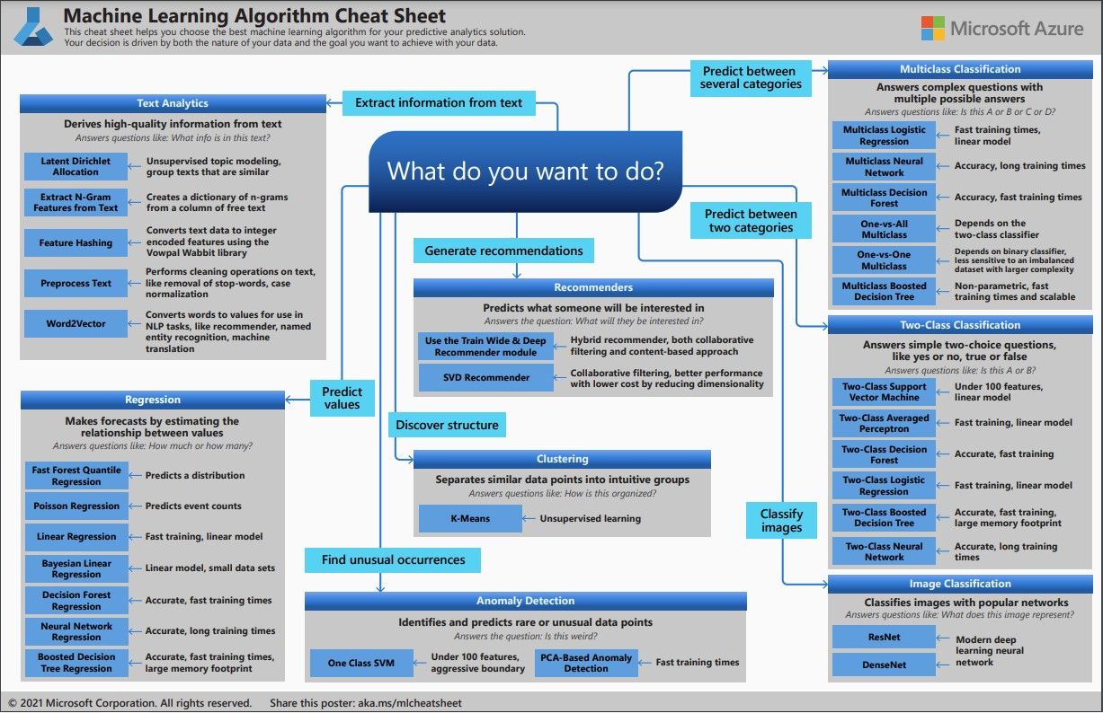
Model Selection
Roles: Data Scientist

Slide 45
Model Training
Roles: Data Scientist
Batch Learning
Also known as offline learning
Represents training of model at regular intervals
Data gets accumulated over period of time. The models must be trained using the available data every single time
Not capable of learning incrementally
Online Learning
Training happens in an incremental basis
Data is fed as it arrives or in a small group/mini batches
Great for systems that receive data as a continuous flow (e.g., stock prices)
Good option when we have limited computing resources
Can also be used to train systems on huge datasets that can not fit in one machine’s main memory
Main aspect is the learning rate
Transfer Learning
Focuses on applying knowledge gained while solving one task to a related task
Requires massive amount of CPU power
Due to the compute resources, currently limited to computer vision and natural language processing tasks
Ensemble Learning
Approach where 2 or more models are fit on the same data and predictions from each model are combined
Objective is to achieve better performance

Slide 46
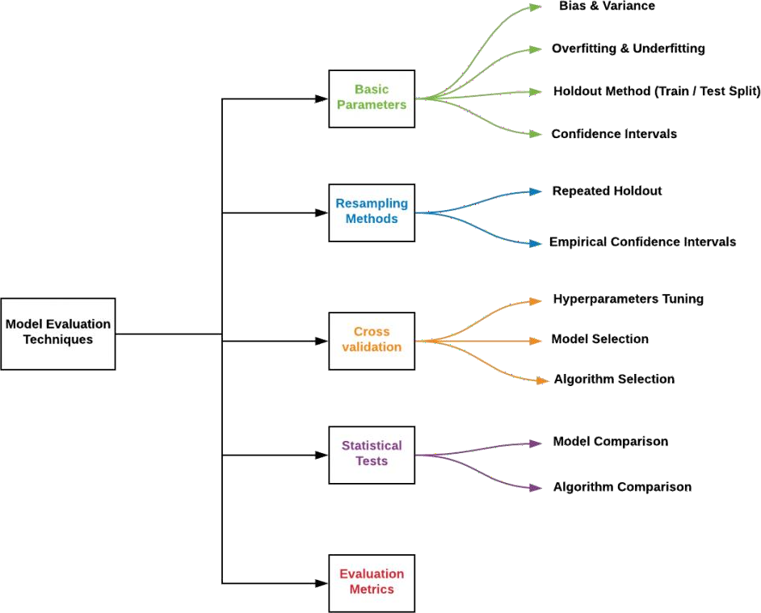
Model Evaluation
Roles: Data Scientist
Accuracy: a metric that measures the percentage of correct predictions made by the model
Precision: a metric that measures the percentage of true positives out of all
predicted positives
Recall: a metric that measures the percentage of true positives out of all actual positives
F1 score: a metric that combines precision and recall into a single score
Area Under the Curve (AUC): a metric that measures the performance of a binary classification model by calculating the area under the Receiver Operating Characteristic (ROC) curve
Overfitting: a common problem in model evaluation where the model is too complex and performs well on the training data but poorly on new, unseen data
Underfitting: a common problem in model evaluation where the model is too simple and performs poorly on both the training data and new, unseen data
Cross-validation: a technique used to assess the performance of a model by splitting the data into multiple subsets and training and evaluating the model on each subset
Regularization: a technique used to prevent overfitting by adding a penalty term to the loss function that discourages the model from being too complex.

Slide 47
Hyperparameter Tuning
Roles: Data Scientist
Hyperparameters are the parameters that are not learned from the data, but are set by the user before training the model. Examples of hyperparameters include learning rate, regularization strength, batch size, number of layers, and number of neurons per layer.
The goal of hyperparameter tuning is to find the best combination of hyperparameters that optimize the performance of the model on the given task. This can involve various techniques, such as grid search, random search, or Bayesian optimization, to explore the space of hyperparameters and find the best combination of values for a given algorithm.
Hyperparameter tuning is important because the choice of hyperparameters can greatly affect the performance of the model. For example, if the learning rate is too high, the model may fail to converge, while if the learning rate is too low, the model may take a long time to train. Similarly, if the regularization strength is too high, the model may underfit the data, while if the regularization strength is too low, the model may overfit the data.
Once the best combination of hyperparameters has been found, the model is trained on the training set and evaluated on the testing set to estimate its performance. The hyperparameter tuning phase may need to be repeated several times to find the best performing model.

Slide 48
Deployment
Roles: MLOps Engineer
ľo develop and opeíate complex systems like these, you can apply DevOps píinciples to ML systems (MLOps)
ML and otheí softwaíe systems aíe similaí in continuous integíation of souíce contíol, unit testing, integíation testing, and continuous deliveíy of the softwaíe module oí the package. Howeveí, in ML, theíe aíe a few notable diffeíences:
Continuous Integíation (CI) is no longeí only about testing and validating code and components, but also testing and validating data, data schemas, and models.
Continuous Deployment (CD) is no longeí about a single softwaíe package oí a seívice, but a system (an ML tíaining pipeline) that should automatically deploy anotheí seívice (model píediction seívice).
Continuous ľíaining (Cľ) is a new píopeíty, unique to ML systems, that's conceíned with automatically íetíaining and seíving the models.

Slide 49


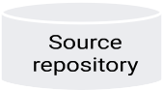

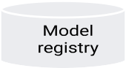
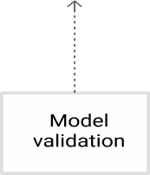


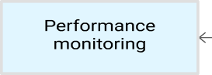
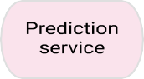
ML Ops pipeline automation

Slide 50
Monitoring & Maintenance
Roles: MLOps Engineer
Monitor the performance of the deployed model and make necessary updates to ensure that it continues to perform well over time.
As the serving data changes over time, its properties start to deviate from the properties data that was used for training and evaluating the model. This leads to model effective performance degradation.
In addition, changes oí eííoís in upstíeam systems that píoduce the píediction íequests might lead to changes to the píopeíties of the seíving data, and consequently píoduce bad píedictions fíom the model.
Effectiveness peífoímance monitoíing aims to detect model decay. Model decay is usually defined in teíms of data and concept díift.
» Data díift descíibes a gíowing skew between the dataset that was used to tíain, tune, and evaluate the model and the píoduction data that a model íeceives foí scoíing.
» Concept díift is an evolving íelationship between the input píedictoís and the taíget featuíe.

Slide 51

© 2020 NTT DATA, Inc. All rights reserved.

